Slide 1
Getting started with DOM.

Slide 2
What is Document Object Model (DOM)
The Document Object Model (DOM) is an application programming interface (API) for manipulating HTML documents.
The DOM represents an HTML document as a tree of nodes. The DOM provides functions that allow you to add, remove, and modify parts of the document effectively.
Note that the DOM is cross-platform and language-independent ways of manipulating HTML and XML documents.

Slide 3
A document as a hierarchy of nodes
<html>
<head>
<title>JavaScript DOM</title>
</head>
<body>
<p>Hello DOM!</p>
</body>
</html>

Slide 4
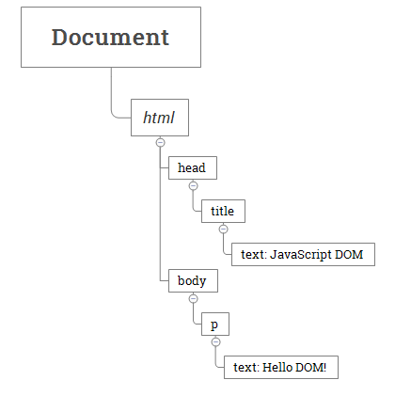
The following tree represents the above HTML document:

Slide 5
Selecting elements
getElementById() – select an element by id
The document.getElementById() method returns an Element object that represents an HTML element with an id that matches a specified string.
If the document has no element with the specified id, the document.getElementById() returns null.
Because the id of an element is unique within an HTML document, the document.getElementById() is a quick way to access an element.
Syntax of the getElementById() method:
const element = document.getElementById(id);

Slide 6
getElementById() method example
<html>
<head>
<title>JavaScript getElementById() Method</title>
</head>
<body>
<p id="message">A paragraph</p>
</body>
</html>
<script type="text/javascript">
const p = document.getElementById('message');
console.log(p);
</script>

Slide 7
Output:
A paragraph
Output in Console:
<p id="message">A paragraph</p>

Slide 8
Example 2
<!DOCTYPE html>
<html>
<body>
<h2>JavaScript Demo</h2>
<h1>Heading Tag.</h1>
<p id="demo1">Not creating a Id of this tag</p>
<span id="demo3">JavaScript</span>
<h1 id="demo"></h1>
<script>
document.getElementById("demo").innerHTML = ‘Welcome to the javascript';
document.getElementById("demo1").style.color = "red";
document.getElementById("demo3").style.color = "green";
</script>
</body>
</html>

Slide 9
getElementsByClassName
The getElementsByClassName() method returns an array-like of objects of the child elements with a specified class name.
The getElementsByClassName() method is available on the document element or any other elements.
When calling the method on the document element, it searches the entire document and returns the child elements of the document:
let elements = document.getElementsByClassName(names);

